Slide 1
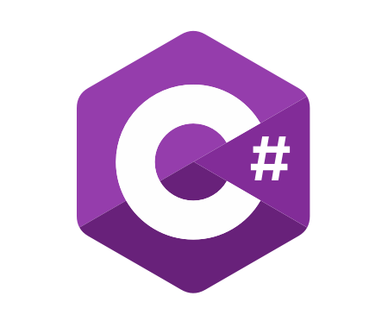
C# OOP
Course Introduction
SoftUni Team
Technical Trainers
Software University
https://softuni.bg/

Slide 2
Table of Contents
Course Objectives
Training and Team
Course Organization
Course Infrastructure
Evaluation Criteria

Slide 3
Have a Question?
sli.do
#csharp-advanced

Slide 4














SoftUni Diamond Partners

Slide 5

Course Objectives

Slide 6
Why OOP?
Object-oriented programming is an important paradigm
Anyone involved in software development should be familiar with OOP and Object-oriented modelling
All modern languages are either object-oriented or support classes and objects
Modern frameworks, libraries and APIs are object-oriented
OOP is a basic requirement for starting a job as developer
6

Slide 7
Practical Exam
2 practical problems for 4 hours:
Create a simple project that:
Follows the OOP principles
Implements functionality based on a description
Test a provided class
Automated judge system with real-time feedback
Upload a zip project to the judge system
7

Slide 8
Theoretical Exam
You will have 30 minutes once you enter
Multiple-choice with 1 or more correct answers
English
Automated quiz system
Available during the practical exam and 30 minutes after it
You can submit your answers just one time
Advice: Start it when you finish the practical exam
8

Slide 9

The Team

Slide 10
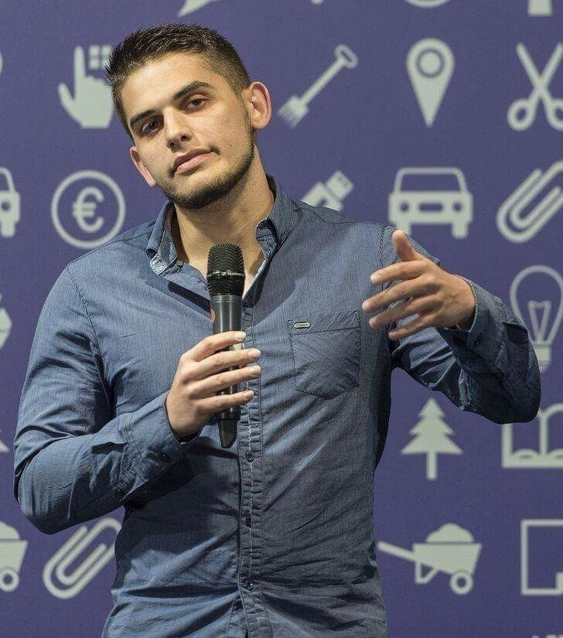
Viktor Dakov
Senior Developer SDE 3, Nuvolo
Worked at Amazon
John Atanasoff award
Participated in many programming contests
6+ Years of Experience as a Developer

Slide 11
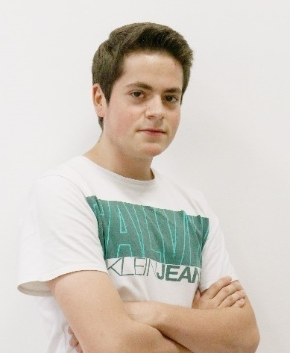
Kristiyan Ivanov
Top Student @ SoftUni
Technical Trainer @ SoftUni
Student @ Technical University of Sofia
Interests include mechanics and electronics
Love playing with Arduino
Mountain lover

Slide 12
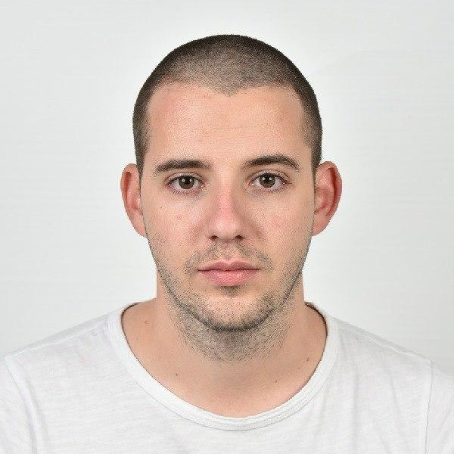
Filip Jordanov
Software Engineer for a Norway Company
Technical Trainer @ SoftUni
Master of business Informatics graduated
from UNWE
SoftUni graduate
Loves travelling and spending time with his family

Slide 13

Course Organization

Slide 14
C# OOP Course – Timeline
27-Oct-2020
12-Dec-2020
19-Dec-2020
C# OOP
7 weeks * 4 times / week
15 credits
Start: 27-Oct-2020
Theoretical Exam: 12-Dec-2020
Practical Exam: 12-Dec-2020
Theoretical Exam Retake: 19-Dec-2020
Practical Exam Retake: 19-Dec-2020

Slide 15

Homework Assignments & Exercises
Your homework is mainly work in class
Lesson days → slides + live demos + exercises
Exercise days → only exercises
How to submit your homework?
Submit in the judge system
Do your homework when it's due
Assignments pile up quickly

Slide 16


SoftUni Certificate
Practical Exam 100%
Homework 5%
Evaluation
16

Slide 17
CPE Certificate
Theoretical Exam 100%
Evaluation
17

Slide 18



Course Web Site, Forum and FB Group
Official web site:
Official discussion forum:
Community Facebook group:
https://softuni.bg/trainings/3008/csharp-oop-october-2020#lesson-16652
https://softuni.bg/forum/categories/15/csharp-oop-advanced
https://www.facebook.com/SoftUniCSharpCommunity/

Slide 19
Questions?
Notes:
19

Slide 20
Trainings @ Software University (SoftUni)
Software University – High-Quality Education, Profession and Job for Software Developers
softuni.bg, about.softuni.bg
Software University Foundation
softuni.foundation
Software University @ Facebook
facebook.com/SoftwareUniversity
Software University Forums
forum.softuni.bg
20
Notes:
20

Slide 21

License
This course (slides, examples, demos, exercises, homework, documents, videos and other assets) is copyrighted content
Unauthorized copy, reproduction or use is illegal
© SoftUni – https://about.softuni.bg
© Software University – https://softuni.bg
Notes:
21

